Slide 1


Re-Think Refrigeration.
Re-Think with Oxford and Make Tomorrow, Today
Oxford Energy Solutions Inc. offers a Long-Term Solution not a Service Contract.
www.oxfordenergy.ca

Slide 2
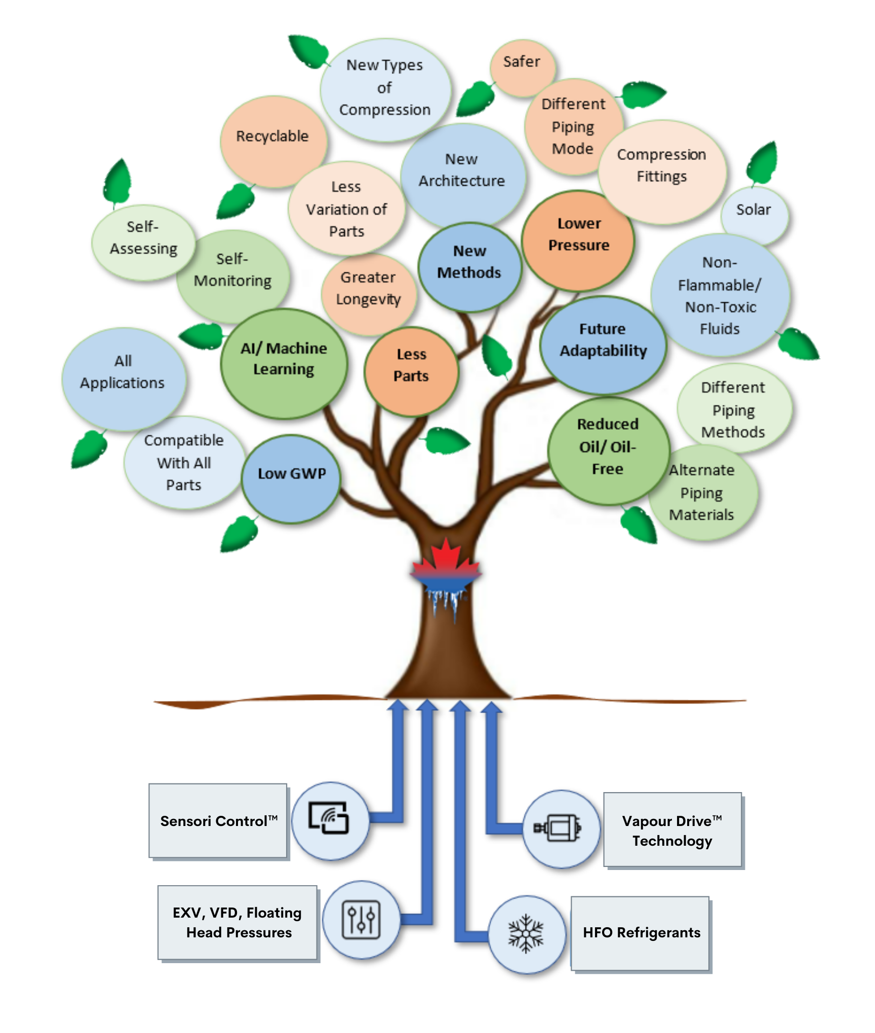
Refrigeration Designed for Today
No other system on the market can offer the number of verticals that the OLPP can provide:
Considers the Total Life Cycle Cost of the machine
Eliminates unnecessary parts
Zero-leak rate strategy
Less energy = less overall environmental impact
Unlimited future adaptability
Lowest GWP design with HFO refrigerants
Best TEWI performance

Slide 3


High Maintenance Costs
Leaks and Refrigerant Charge Loss
Inefficient Operating Costs
Blind Troubleshooting
Extra Labour
Future Refrigerants
Life Cycle Costs
Longevity
Owners of inefficient conventional systems bear the expense of unaddressed design issues and dig deeper into shrinking pockets.
Oxford Energy Solutions Inc. is challenging inefficient designs and addressing:

Slide 4
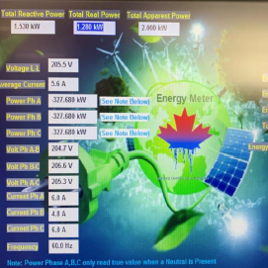
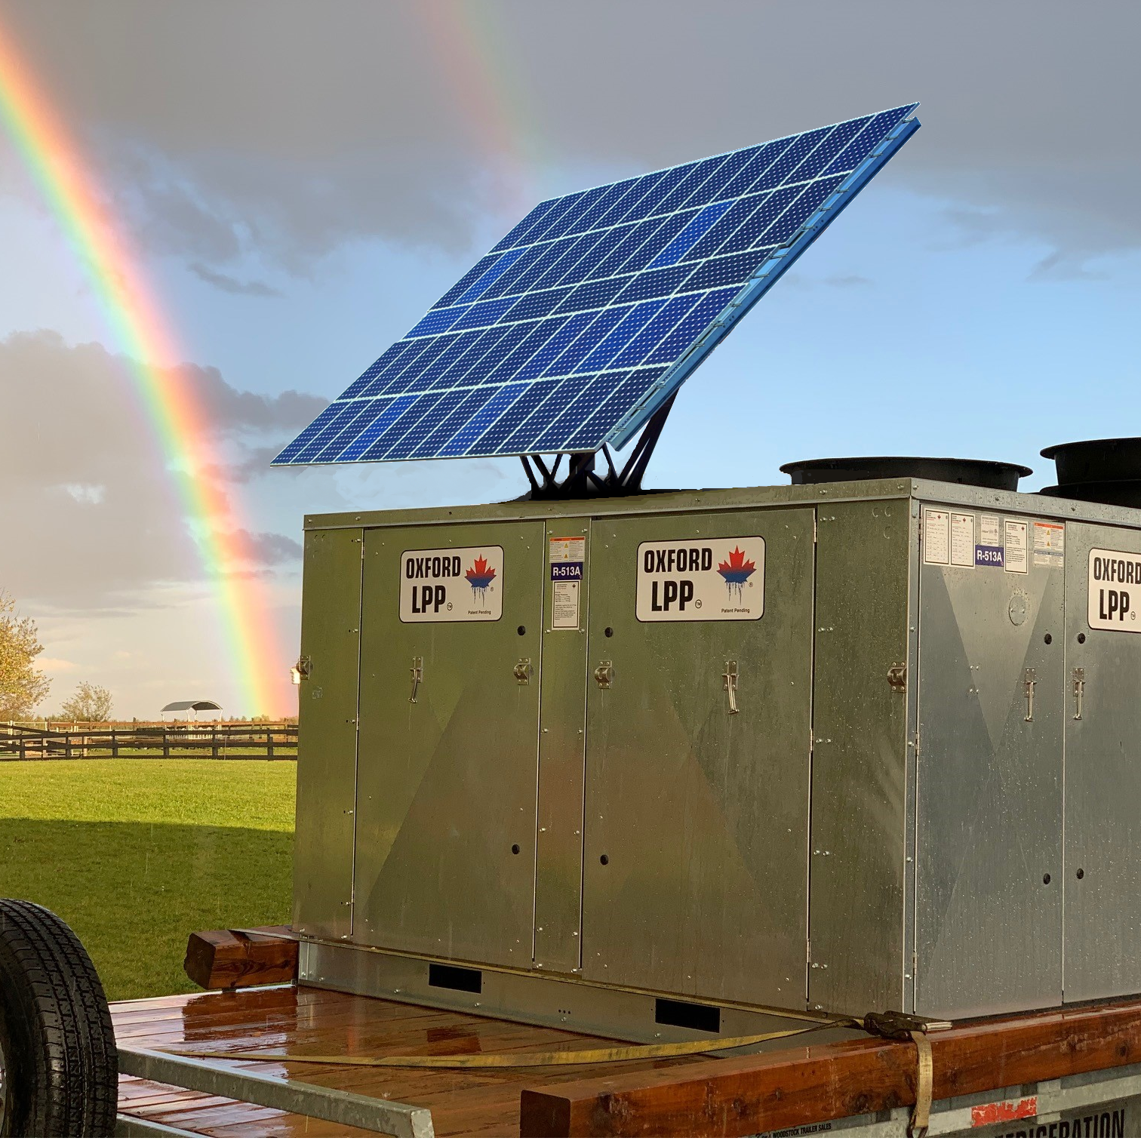
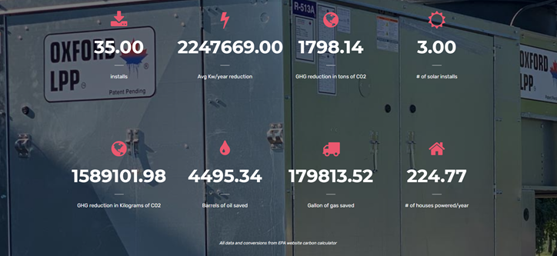
Oxford Low-Pressure Platform - OLPP
Built with a zero-leak rate approach and no ambient limitations
Future adaptability, standard solar kit integration
100% designed around advantages of low-pressure refrigerants
Eliminates conventional components, no need for cumbersome safeties

Slide 5
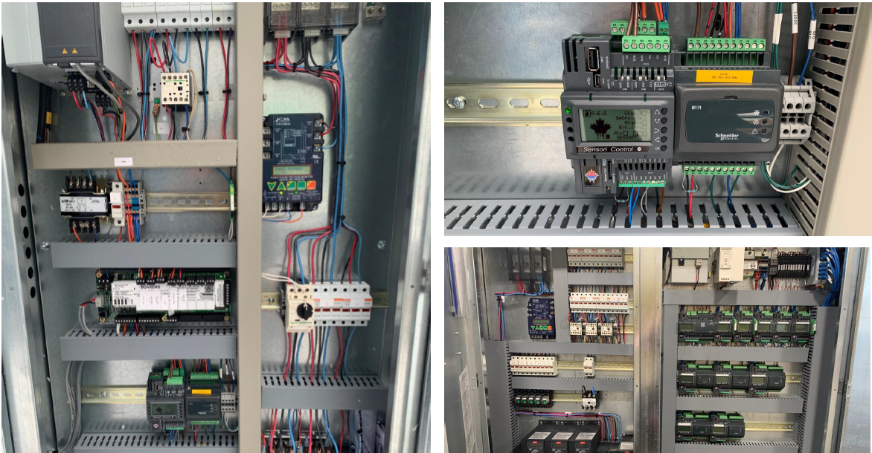
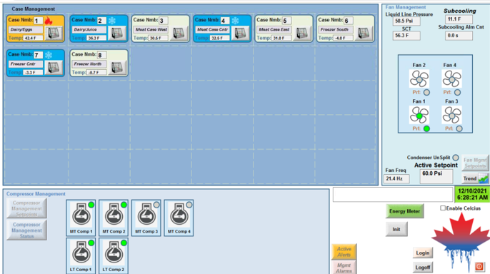
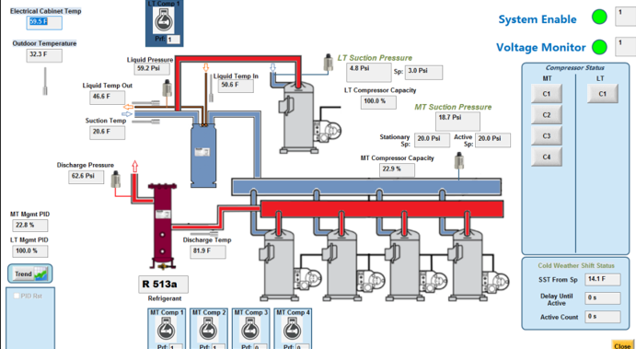
Oxford Sensori™ Control System
Highest level of cyber security, plug & play system
Advanced controls – reduced manual effort, no set-up required
Integrated system, machine learning/adaptive predictability
Adapts to ambient conditions, temperature changes, load profiles
Full redundancy for stand alone or connected systems
On premises analytics as well as cloud-based, remote connectivity

Slide 6
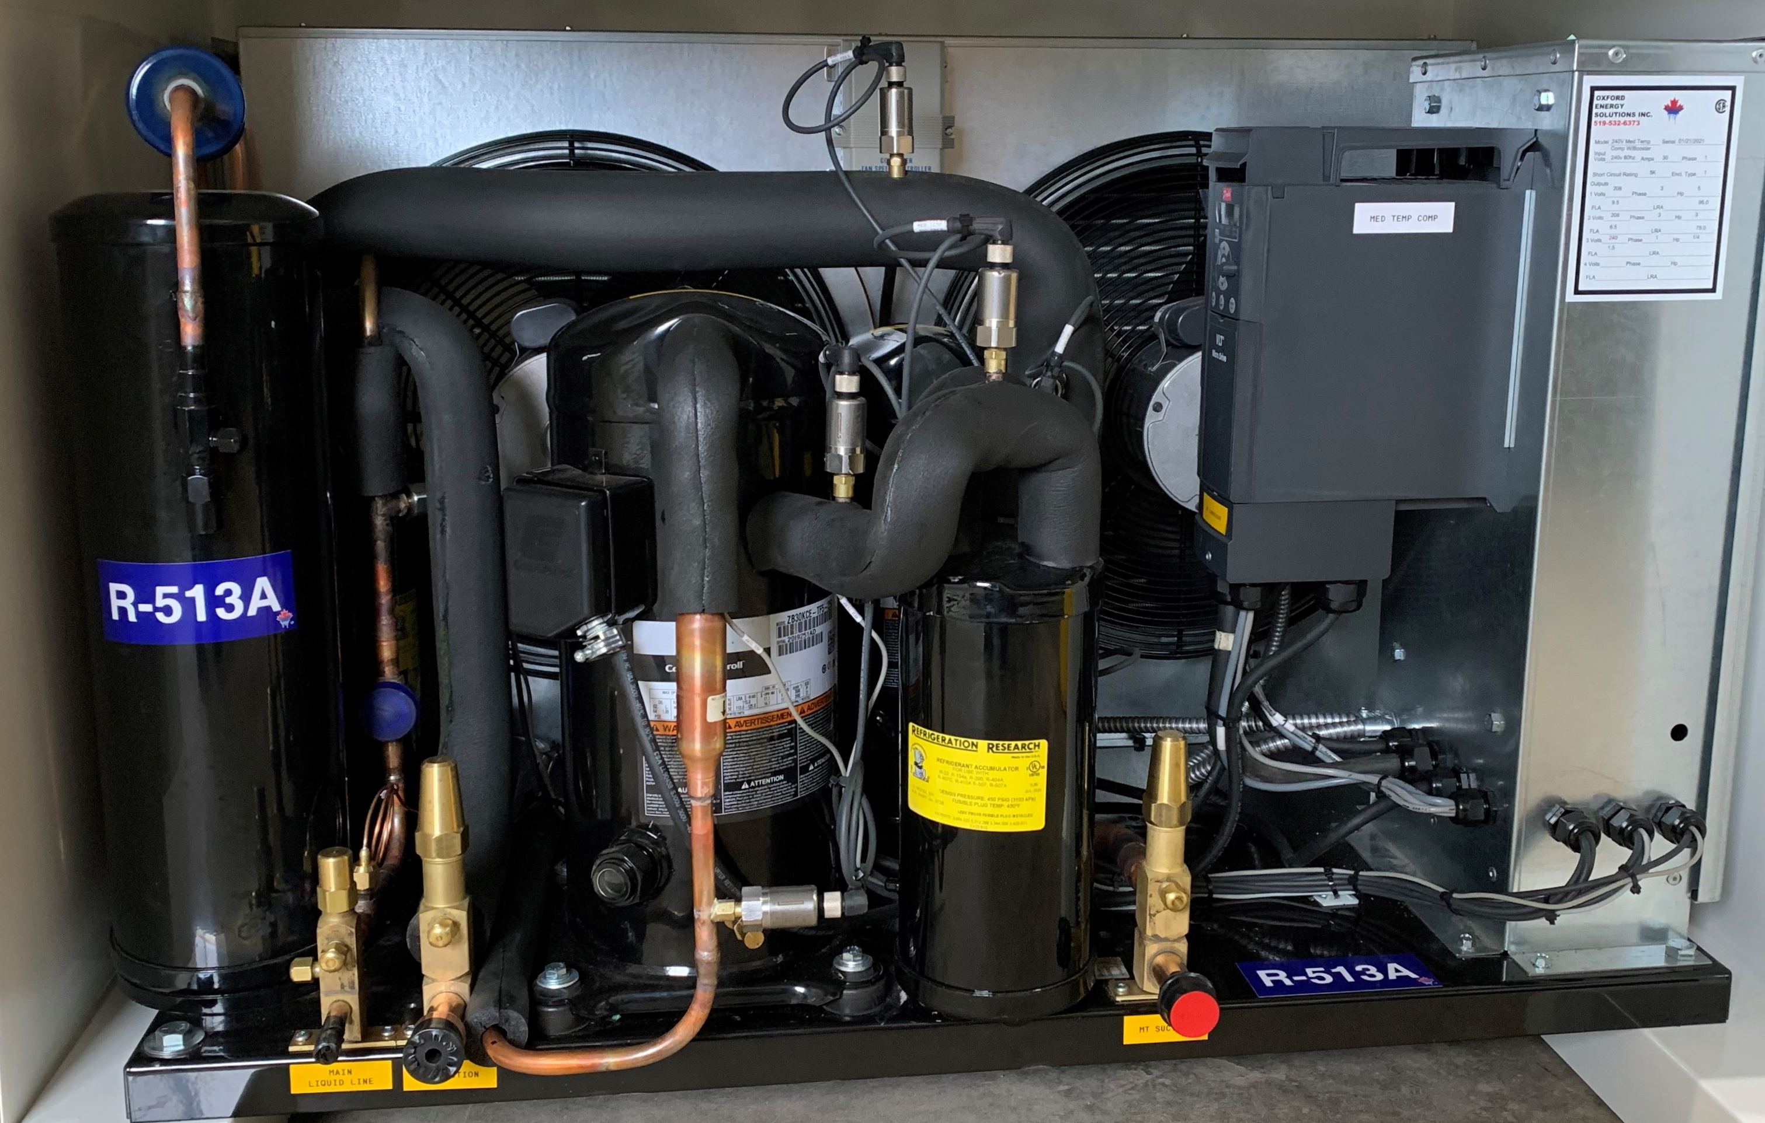
Ultra Low GWP - Zero ODP HFO Refrigerant
Reducing harmful emissions with a GWP of approximately 60% lower than HFCs
Low-pressure, ultra-low GWP, zero ODP, HFO based refrigerant, R-513a and R-515b
Dramatically reduced refrigerant charge - maintaining a 50lb or lower (small stores etc.)

Slide 7
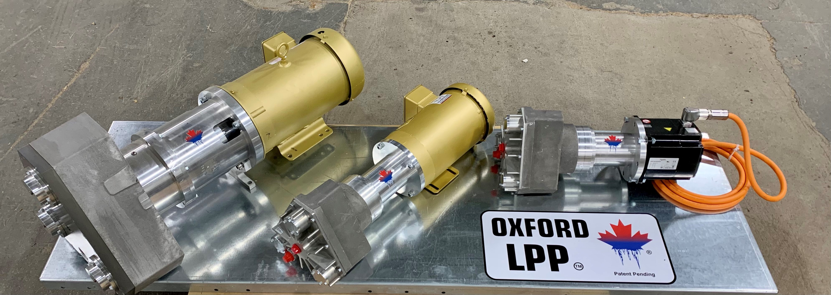
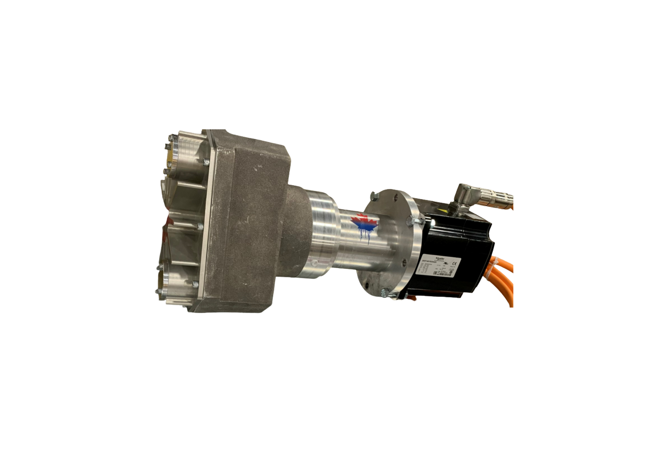
Oxford’s Vapour Drive™ Technology
Oil-less, field-repairable, magnetic-drive scroll compressor
Operates from 0% to 100% load
Compatible with standard oil, oil-reduced or oil-free system
Reduces energy consumption, system complexity, maintenance
2 standard sizes, run at variable rates to match load

Slide 8
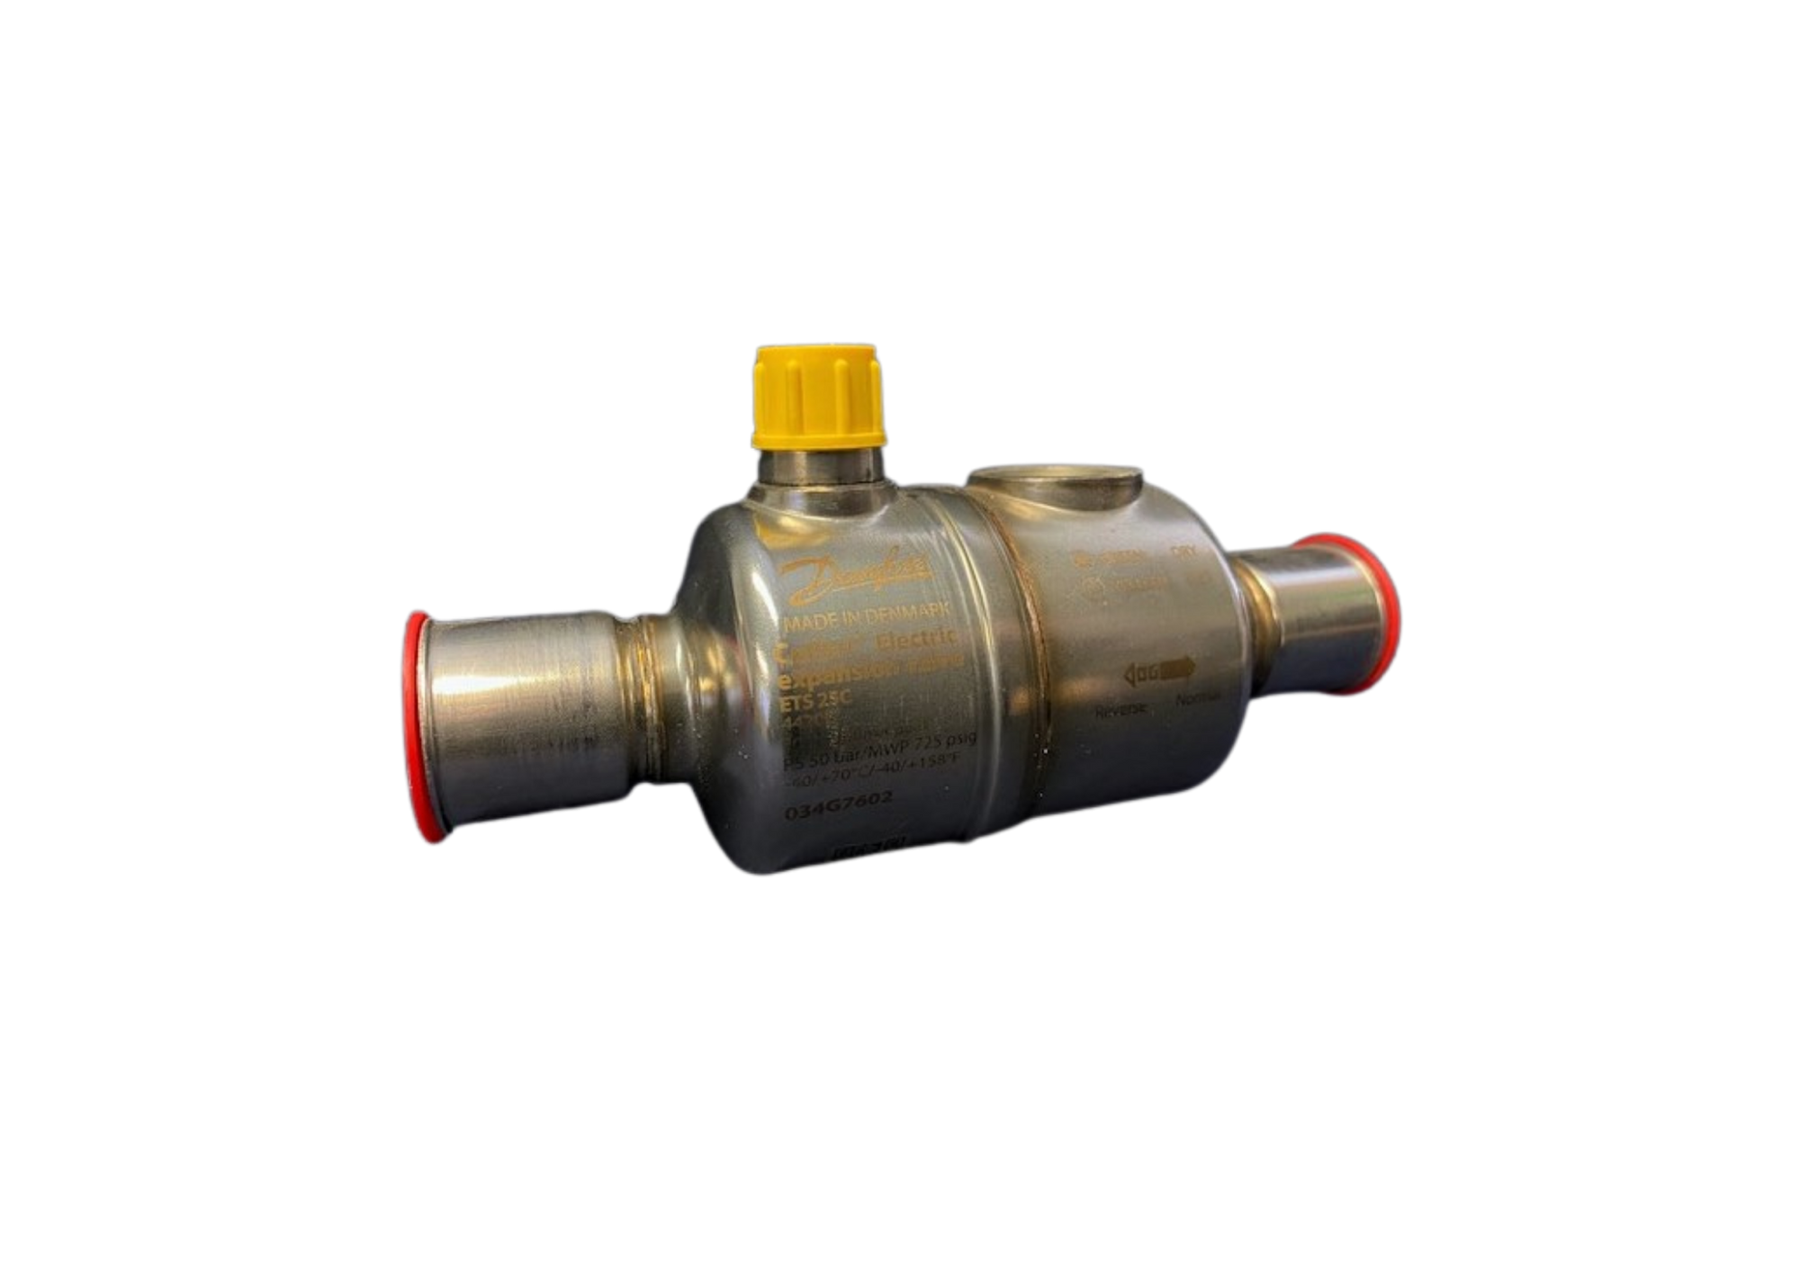
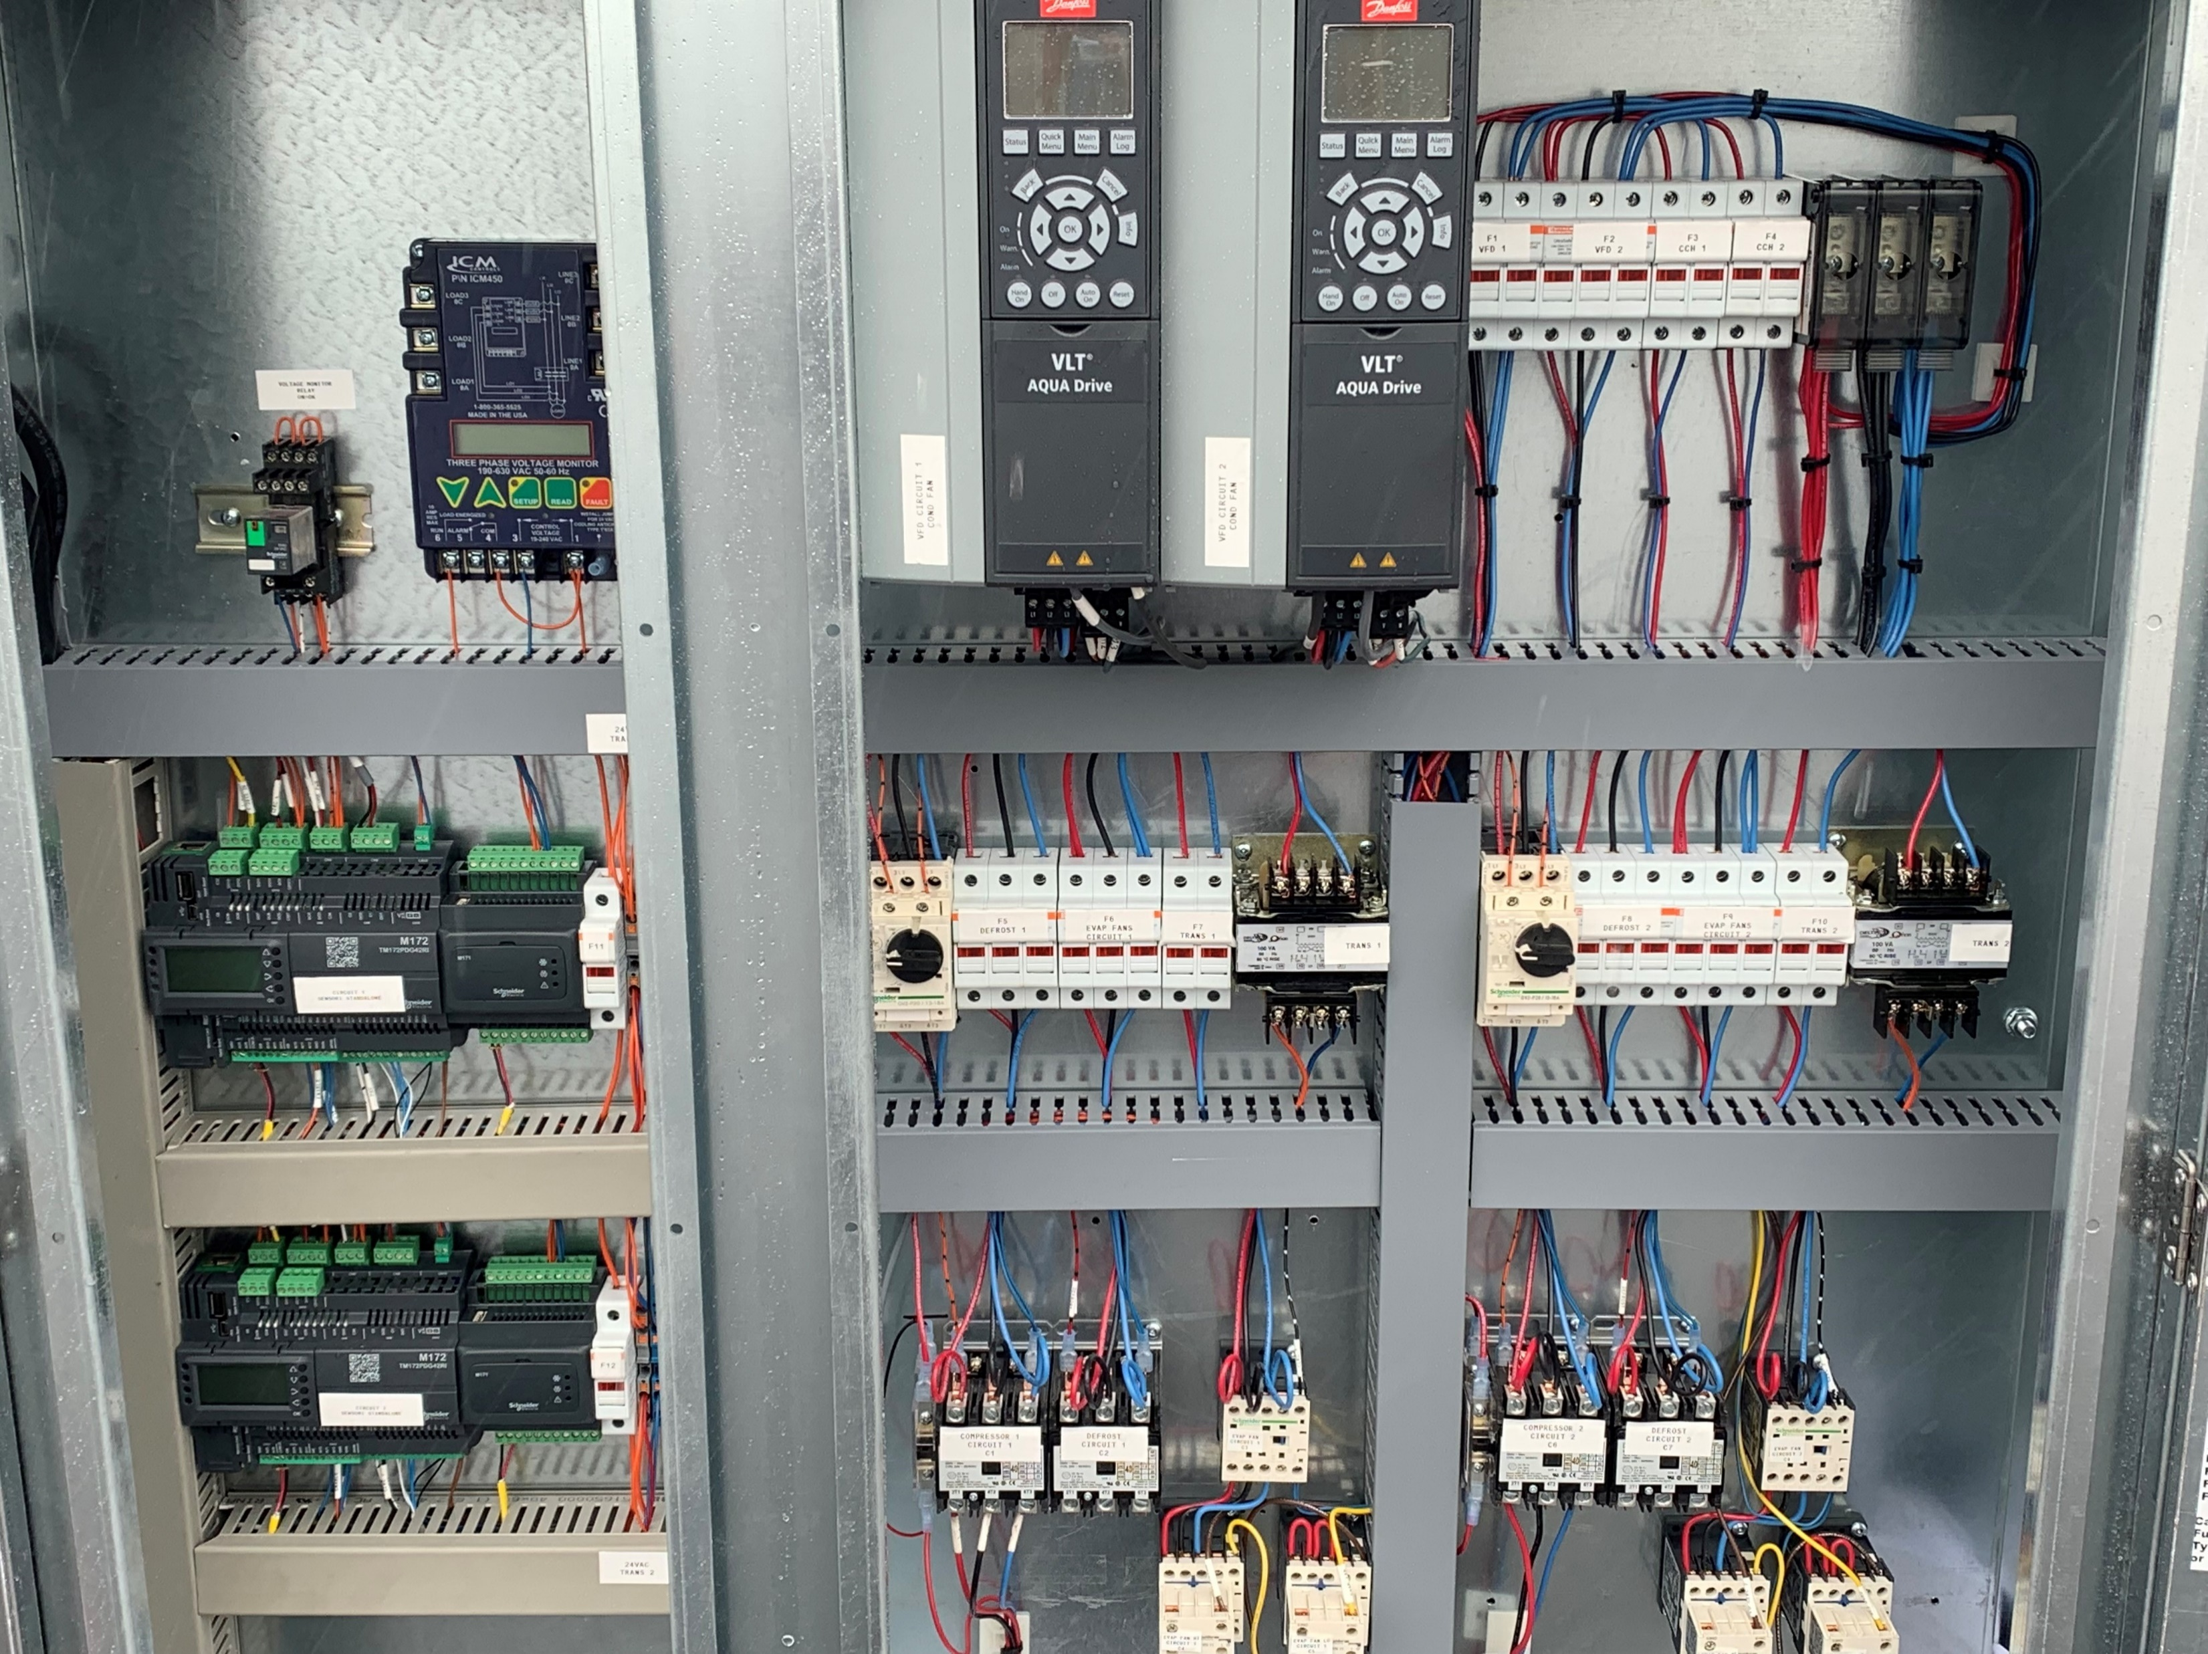
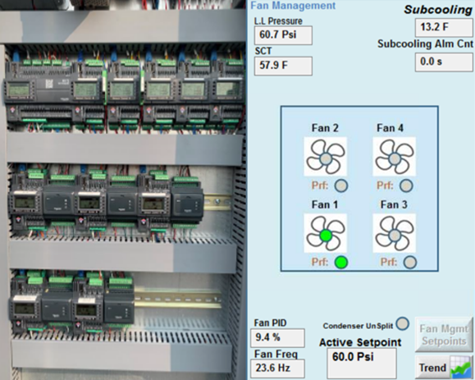

EXV- Electronic Expansion Valves
Floating Head Pressure
Floating head pressure takes advantage of lower ambient temperatures
Stable system pressures, increased overall refrigeration effect and smooth operation
Auto-configuring system requiring no programming for valves
Bipolar, fully hermetic electronic expansion valve, integrated with Sensori Control optimizes the control of refrigerant
No solenoid valves
VFD- Variable Frequency Drives
Smooth start-up and shut-down processes
elimination of system hammering, and cycle vibration
optimize the operation of compressors and condenser fans

Slide 9
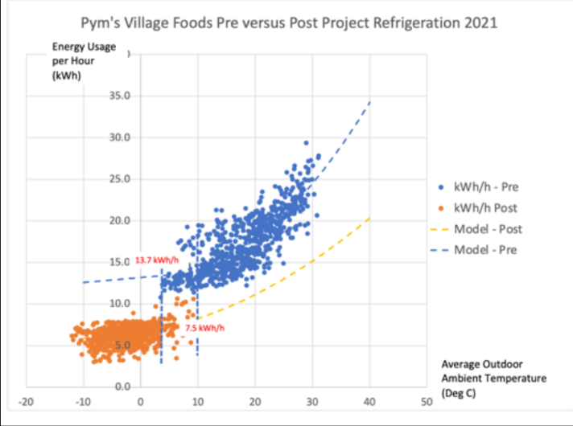
Operating a store with legacy individual refrigeration systems/circuits?
Check out the comparison to the OLPP
Post-Project OLPP Savings

