Slide 1
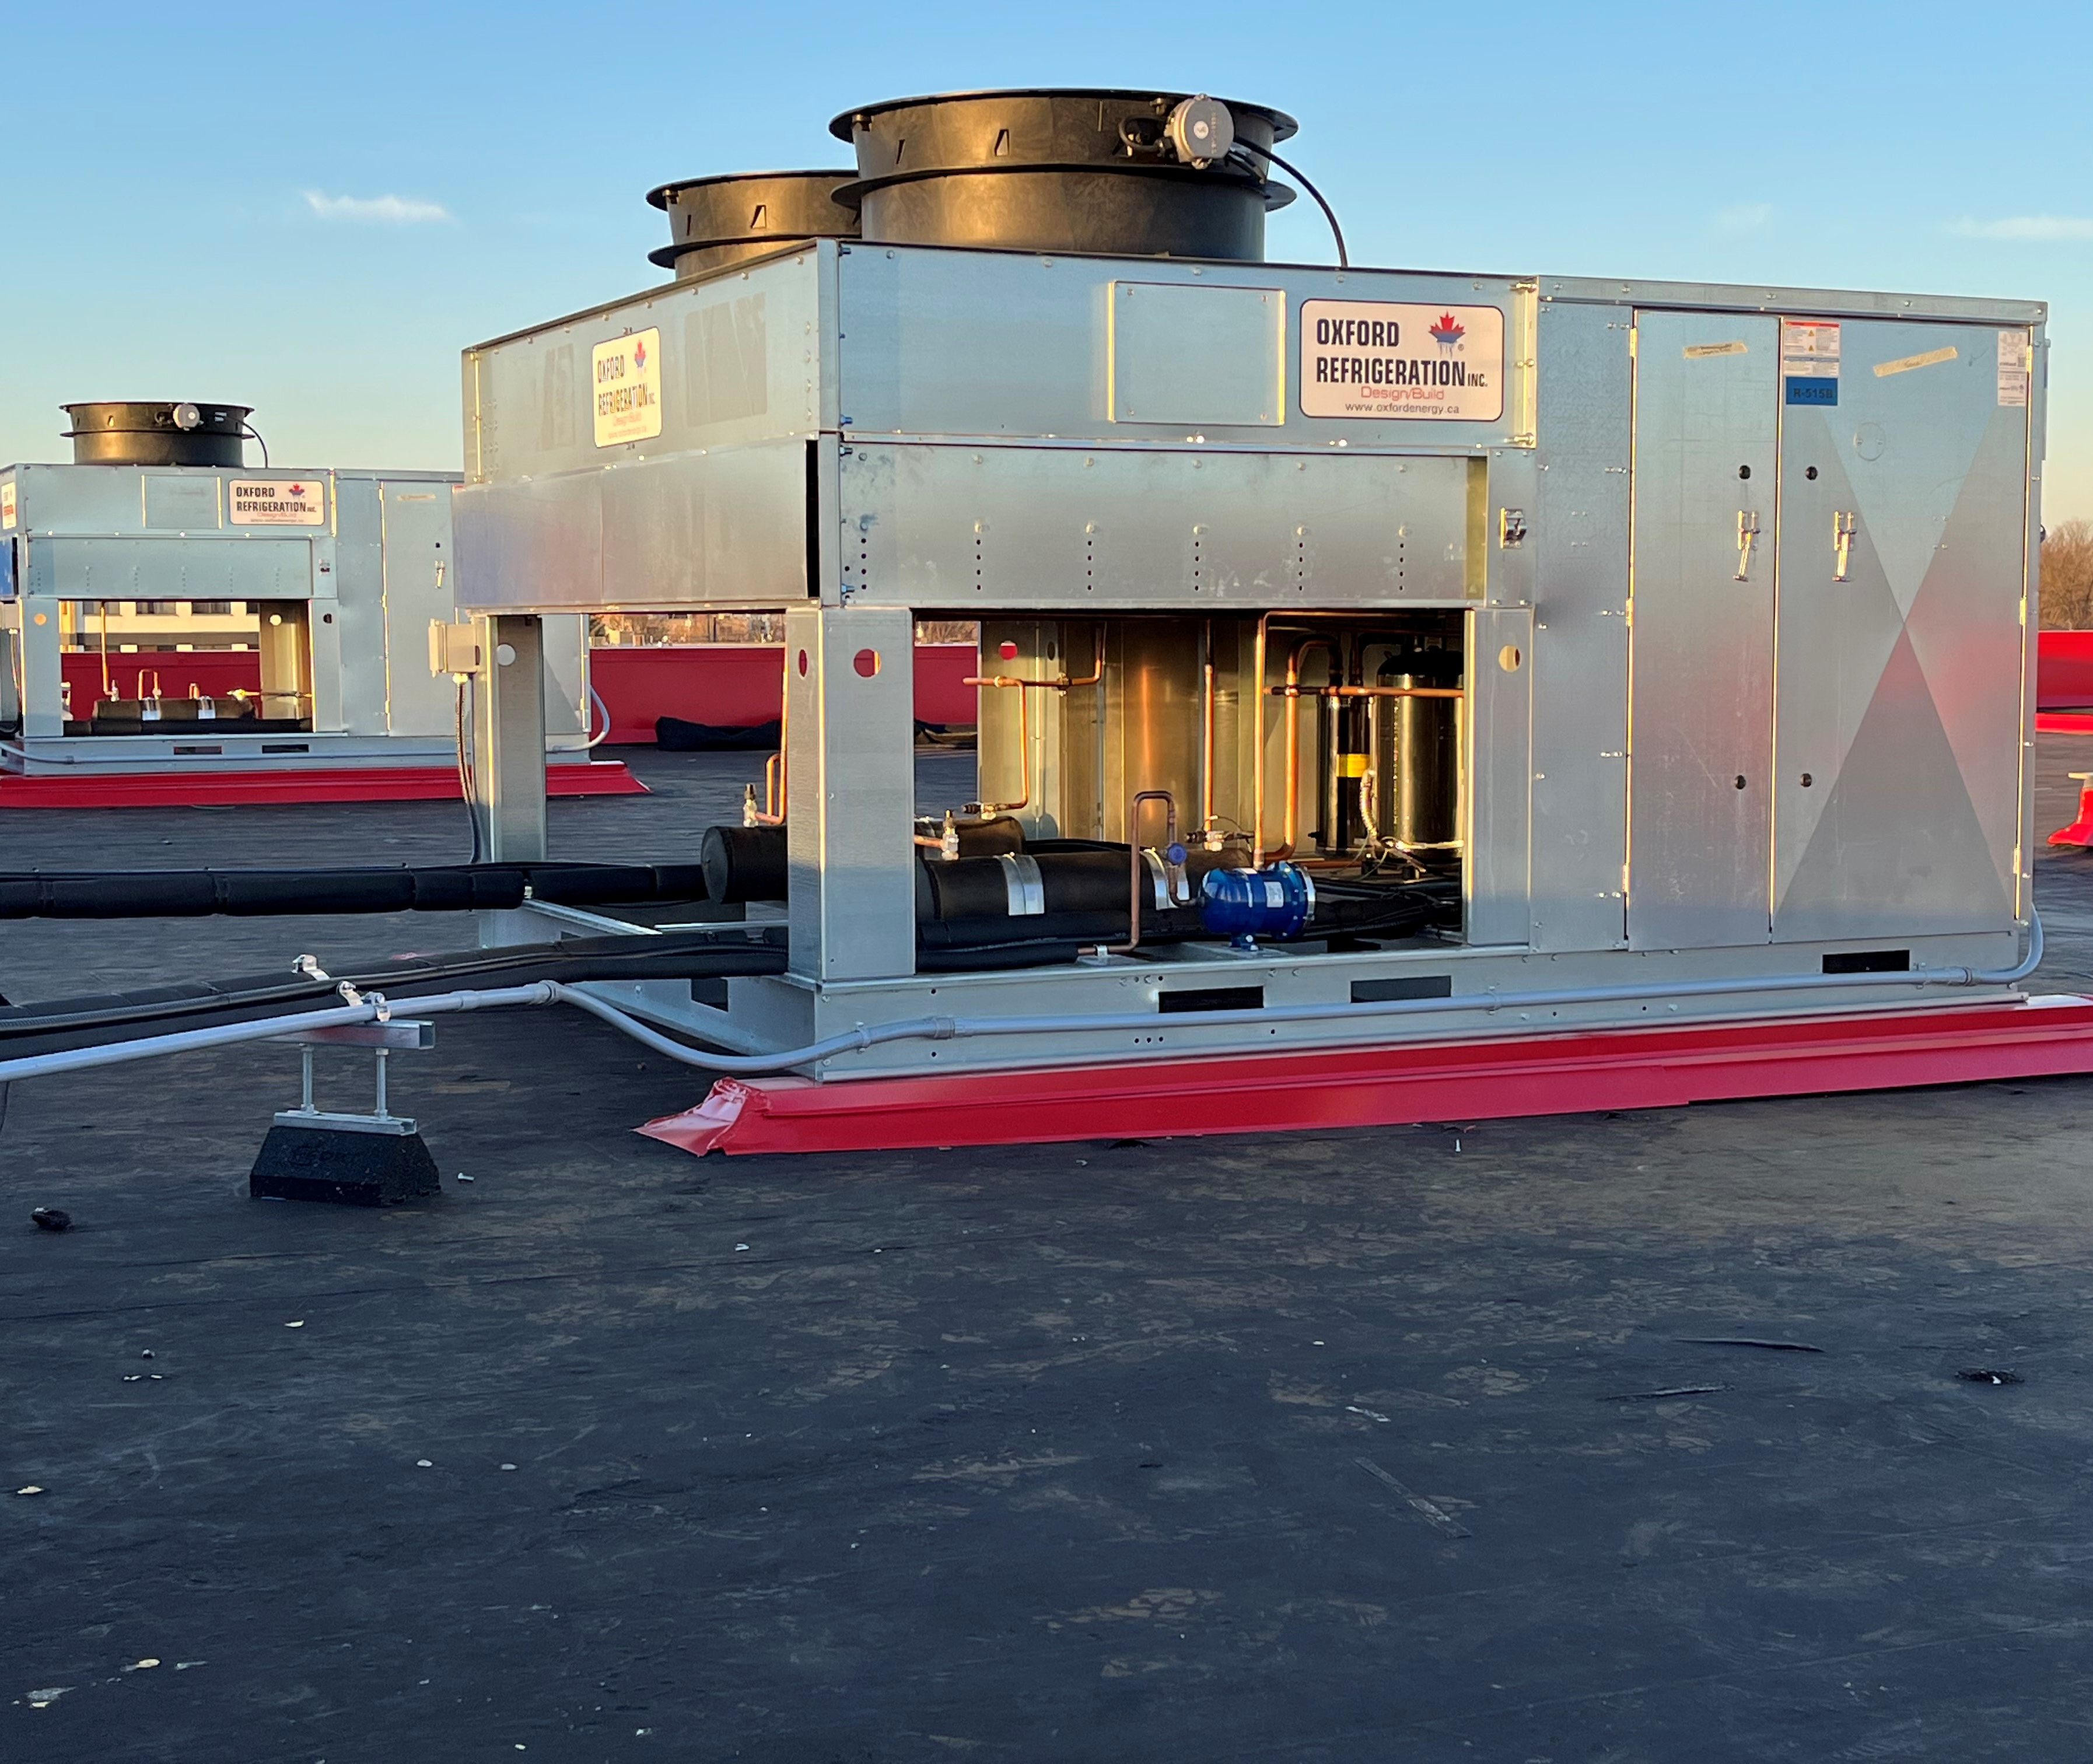


OLPP
Reduces Environmental Impact With a Zero Leak-Rate Design
www.oxfordenergy.ca
The OLPP is designed with its entire life in mind

Slide 2

The Entire Life of a System Matters
How were the parts made?
How did they get here?
Are the parts necessary? Efficient? Recyclable/Reusable? Oil-Dependent?
How were the fuels produced?
What happens to the parts at the end of life?
We need to know how every part of a system impacts the environment during its life cycle

Slide 3
Refrigerant Choice
It is typical to think of refrigerants first in considering the impact of refrigeration
Some refrigerants are greenhouse gasses that pose environmental threats
Leaked refrigerant affects system efficiency, requiring increased energy consumption
It is important to know the limitations of refrigerants so that we can select them responsibly

Slide 4
Comprehensive Refrigerant Decisions
Consider More Than GWP
Think about:
Refrigerant Production Processes
  CO2, NH3 produced through the burning of fossil fuels, energy-intensive processes = significant negative impacts on the environment
Potential Environmental Effects Post-leak
  Refrigerant Attributes (toxicity/flammability levels)
  Local air quality, ecosystem effects, occupational health/safety risks
Additional Input of Natural Resources
  Some systems depend on great amounts of water for heat-rejection
Refrigerant Pressure
  Higher pressures stress components increasing leak potential
  Higher pressures need additional specially-designed pressure safety devices
Refrigerant Charge
  Many systems hold hundreds of pounds of refrigerant in designs with high leak potential- raising environmental risk

Slide 5

Zero Leak-Rate Strategy
A system should operate within normal parameters its entire usable life without needing additional refrigerant
Conventional systems have an allowable leak-rate
All OEMs should be designing equipment around a zero leak-rate
There are many opportunities in the designing of a system to achieve a zero leak-rate

Slide 6
Design Opportunities To Minimize the Impact of Leaks On Emissions
Use of low-pressure, low GWP refrigerants
Reduction of refrigerant charge
Reduction of refrigeration capacity demand
Improved components
Recovery and reuse of refrigerant during service & decommission
Integrated smart controls for system monitoring

Slide 7
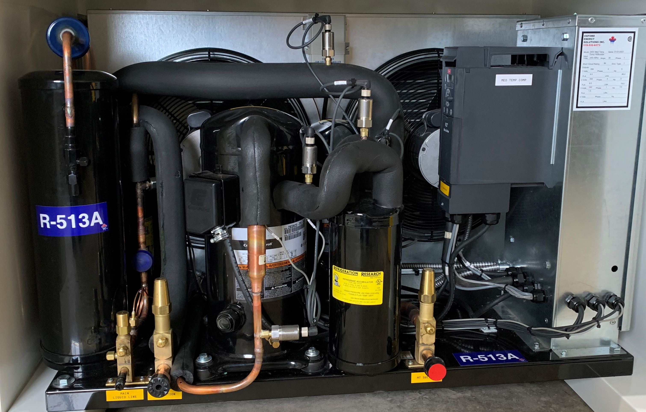
Ultra Low GWP - Zero ODP HFO Refrigerant
By combining better chemicals with a more solid platform, equipment design mitigates refrigerant leakage that conventional systems
normalize
Reducing harmful emissions with a GWP of approximately 60% lower than HFCs
Low-pressure, ultra-low GWP, zero ODP, HFO based refrigerant, R-513a and R-515b
Dramatically reduced refrigerant charge

Slide 8
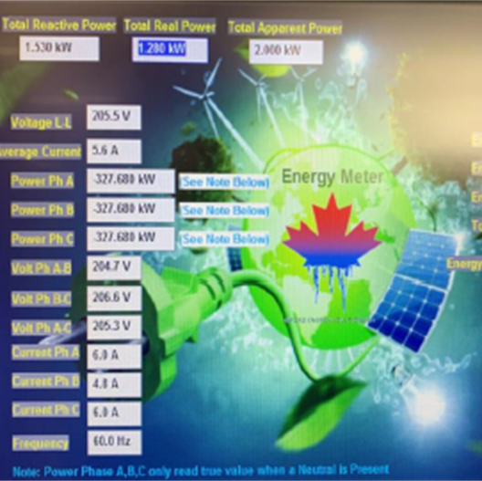
Energy Consumption
Equipment Contributions To Emissions Exceeds GWP
Industrial processes that produce electricity to operate systems produce CO2 emissions
75 - 80% of energy used today comes from burning finite resources
Every part of a system affects how much energy is needed
Ambient temperatures directly affect energy consumption

Slide 9
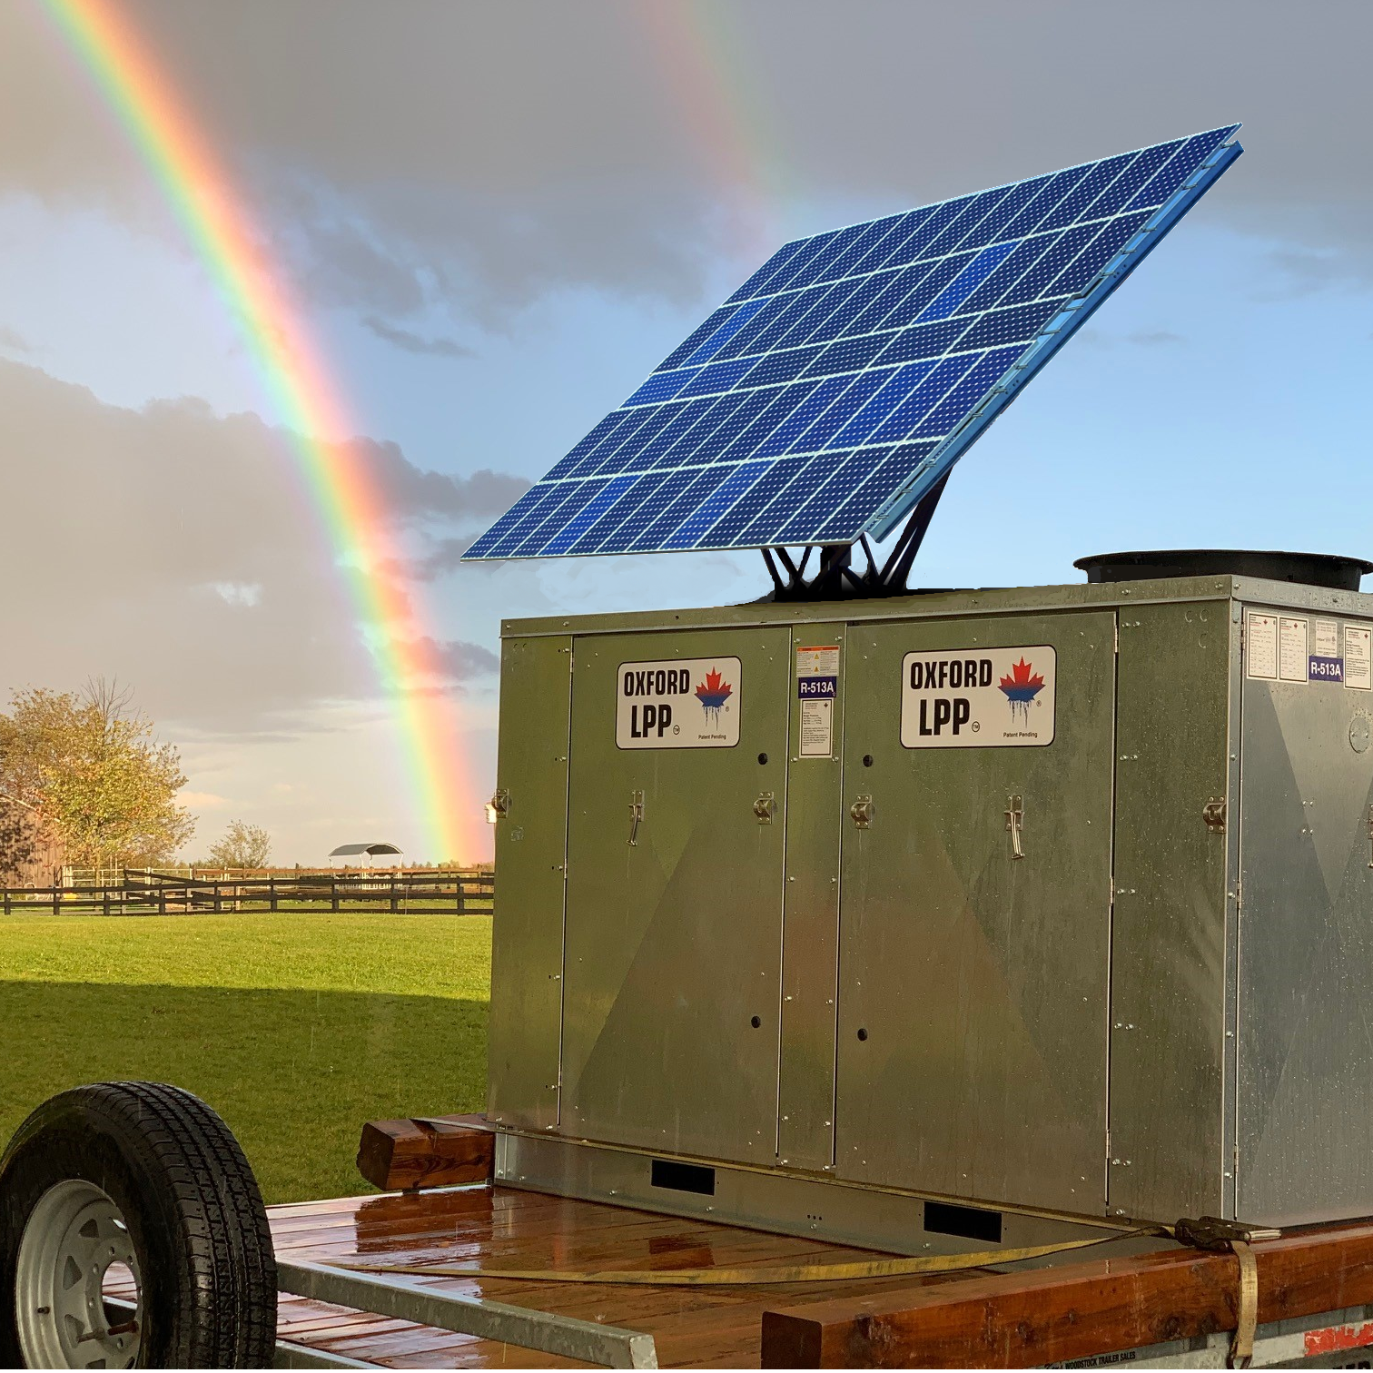
Design Opportunities To Minimize the Impact of Energy Consumption
Future adaptability / standard solar kit integration
Design to use lowest operating refrigerant pressure differentials as possible
No fixed temps- components should allow the required energy to fluctuate in relation to ambient (EXV, VFD, floating head pressure)
Integrated system to monitor equipment performance and enhance system control

Slide 10
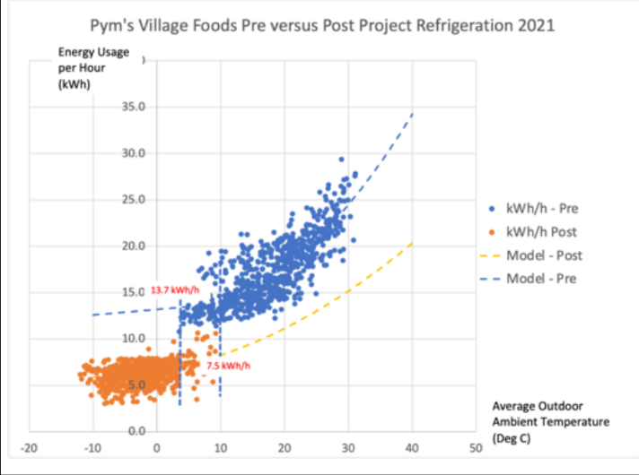
Operating a store with legacy individual refrigeration systems/circuits?
Check out the comparison to the OLPP
Post-Project OLPP Savings

Slide 11
Components/Technology
Systems are designed with certain operating conditions in mind. These parts have a specific set of tolerances
Designs must take advantage of fluctuating ambient conditions to decrease energy consumption
System design should focus on the best product, devices, chemical for the application- not the cheapest

Slide 12
Conventional Components/ Technology
Mechanically driven and unnecessary parts create secondary issues, increased points of failure, maintenance and down-time
Typical oil-dependent piston and scroll compressor designs are prone to additional high cost of oil, installation limitations and operational limitations
Mass-produced, low-cost components are built to last past-warrantee, without system in mind
Out-dated, ineffective controls increase energy consumption, higher pressure operation, causing stress on components (Switches/springs, diaphragms/gauges, valves, gaskets…)
When components work harder to get the same results, the system is stressed and risk instability and reliability
Lacking information and control over system operation inhibits immediate response to anomalies (troubleshooting)
Uses valves and pressure dependent devices to control refrigerant

Slide 13
OLPP Components
Electronically-driven parts delivers better control of system operation
Oil-free/oil-reduced compressors with full modulation from 0-100% allow the reduction of parts, reduction of secondary heat of rejection, and adaptability to any future low pressure GWP refrigerants without changing the system
Electronic Expansion Valves and Floating Head Systems offer lowest pressure functionality which maximizes work being done at the lowest possible kW input.

Slide 14
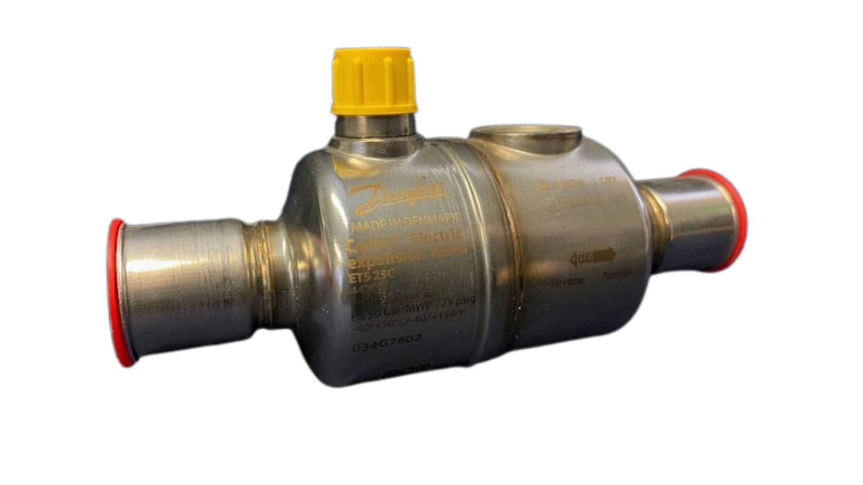
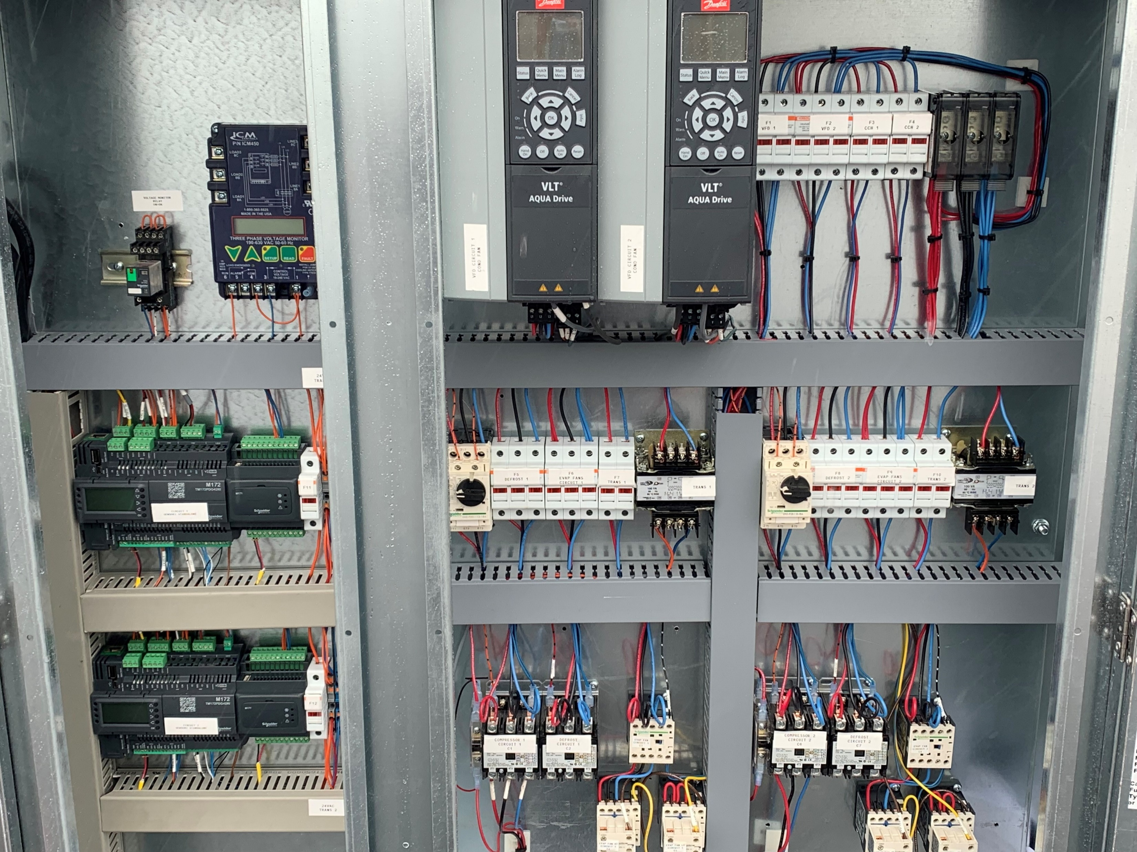
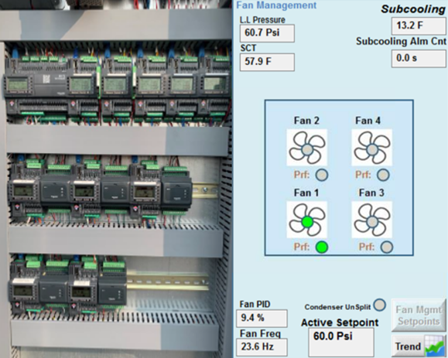
EXV- Electronic Expansion Valves
Floating Head Pressure
Floating head pressure takes advantage of lower ambient temperatures
Stable system pressures, increased overall refrigeration effect and smooth operation
Auto-configuring system requiring no programming for valves
Bipolar, fully hermetic electronic expansion valve, integrated with Sensori Control optimizes the control of refrigerant
No solenoid valves
VFD- Variable Frequency Drives
Smooth start-up and shut-down processes
elimination of system hammering, and cycle vibration
optimize the operation of compressors and condenser fans

Slide 15

OLPP
Technology
Integrated, automated equipment and controls offer smart monitoring of system, analyzing temperature changes, load profiles, and overall usage patterns to develop tailored operating envelopes
Oxford Sensori Control™ architecture provides a platform for conventionally independent parts—pumps, compressors, condenser fans, temperature sensors, evaporators, etc.—to link together in smart and automated communication
Able to detect and receive information regarding cause/effect of anomalies in system with quick resolutions- able to be executed remotely
Limitations caused by high pressures, ambient temperature and mechanical devices have been eliminated
Remote access security is of highest priority- no IT personnel necessary
Enhanced System Control delivers a Significantly Reduced Environmental Impact

Slide 16
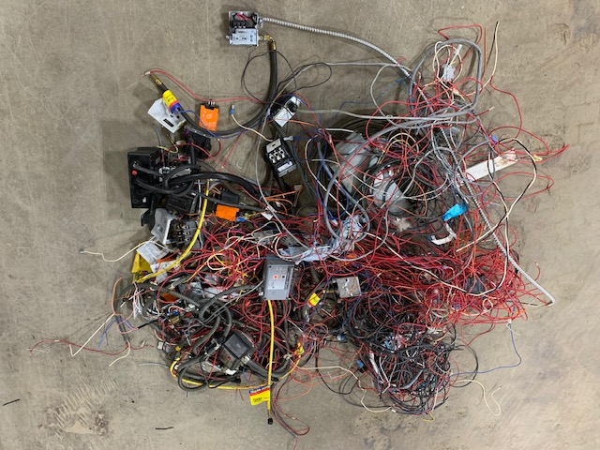
Conventional Systems With Unnecessary Parts And Mechanically-Driven Parts Are… Unnecessary
Increased points of failure, maintenance, downtime
Increased energy for parts, decreased efficiency
Wasted materials that tax disposal sites
Increased cost for manufacturing and repair

Slide 17
OLPP -Gaining More With Less Input
Reduces system complexity, eliminates cumbersome safeties
Replaces pressure dependent components with electronically-controlled devices
Reduces amount of refrigerant needed
Integrates automated equipment with smart controls- eliminating guess work
Low pressure platform eliminates need for high pressures to push refrigerant through system
Water dependency in the refrigeration system’s heat-rejection is eliminated- no need for wasting natural resources
All components designed to reduce both direct and indirect environmental impacts
Automatically integrate today’s evaporator ECM/multi-speed fans

Slide 18

Estimated Carbon Footprint Comparison From a Retrofit
Refrigerant GHG Emissions Comparison
 | ODP | GWP | GWP Reduction Post-Retrofit | Pre-Retrofit Facility Charge | Post-Retrofit Facility Charge | Facility Charge Reduction | Total GHG Reduction
R-22 | 0.05 | 1810 | - | 2800 lbs | 1600 lbs | 1200 lbs | -
R-513a | 0 | 573 | 68% | - | 450 lbs | 41% | 88%
R-515b | 0 | 293 | 84% | - | 450 lbs | 41% | 94%
Energy GHG Emissions Comparison
 | Pre-Retrofit GHG Emissions (tonnes CO2/yr) | Post-Retrofit GHG Emissions (tonnes CO2/year) | Post-Retrofit GHG Reduction
R-22 | 23.7 | - | -
R-513a | - | 16.7 | 30%
R-515b | - | 16.7 | 30%
Reduction of Refrigerant Leak GHG Emissions
 | Pre-Retrofit Leak (tonnes CO2/yr) | Post-Retrofit Leak (tonnes CO2/yr) | Post-Retrofit Leak Reduction
R-22 | 1558 | - | -
R-513a | - | 0 | 100%
R-515b | - | 0 | 100%

Slide 19


Significant Carbon Footprint Reductions
Reduction in GHG emissions for energy (tonnes CO2/yr.)
30%
Reduction in GHG emissions based on refrigerant quantity and quality/type (tonnes CO2/yr.)
94%
The culminating effects of reducing GHG emissions, significant reductions in charge and a zero leak-rate strategy offer unprecedented improvements in overall impact
Reduction in GHG emissions based on refrigerant leak-rate
100%

Slide 20
Long-Term Viability
Conventional System Options |  |  |  | OLPP + HFO Options
R-404a HFC Blend | R-448 HFO Blend | NH3 Ammonia | CO2 | R-513a HFO Blend | R-515b HFO Blend
Short-term, recycled use only Phasing down (gone by 2030) Not allowed in new equipment | Short-term drop-in replacement of R-404a refrigerant due to high GWP | Not suitable for retrofit No future advancement High consumption of secondary inputs High environmental manufacturing impact | Not suitable for retrofit No future advancement High consumption of secondary inputs High environmental manufacturing impact | Unlimited future adaptability Compatible with upcoming HFO refrigerants, retrofits, new systems | Unlimited future adaptability Compatible with upcoming HFO refrigerants, retrofits, new systems

Slide 21

Pressure
Conventional System Options |  |  |  | OLPP + HFO Options
R-404a HFC Blend | R-448 HFO Blend | NH3 Ammonia | CO2 | R-513a HFO Blend | R-515b HFO Blend
Medium pressure operation | Medium pressure operation | Lower pressure operation | High pressures are more hazardous and increase leak potential, causing inefficiency issues | Low pressure differential system accommodates fluctuating ambient temps, saving energy | Low pressure differential system accommodates fluctuating ambient temps, saving energy

Slide 22
Refrigerant Charge Size
Conventional System Options |  |  |  | OLPP Options
R-404a HFC Blend | R-448 HFO Blend | NH3 Ammonia | CO2 | R-513a HFO Blend | R-515b HFO Blend
Conventional systems typically run with higher charges due to design Approximately 2x larger than OLPP | Conventional systems typically run with higher charges due to design Approximately 2x larger than OLPP | Significant charge size- 2-4x larger than OLPP Added responsibility and expense of charge record keeping Flammability and toxicity combined with a large charge emphasizes higher regulations | Significant charge size- 2-4x larger than OLPP High pressures that increase leak potential result in additional replacement charge Ambient operating conditions result in frequent discharge through safety reliefs = increased consumption of refrigerant | Greatly reduced charge Uses only required amount to push refrigerant through the system Built-in refrigerant quantity/quality monitoring | Greatly reduced charge Uses only required amount to push refrigerant through the system Built-in refrigerant quantity/quality monitoring

Slide 23
Additional Inputs for System Operation
Conventional System Options |  |  |  | OLPP Options
R-404a HFC Blend | R-448 HFO Blend | NH3 Ammonia | CO2 | R-513a HFO Blend | R-515b HFO Blend
Typically operates with higher compression rate | Typically operates with higher compression rate | Requires significant amount of water/treatment Additional safety measures | Requires water Need for specialty components, safeties, training | No water dependency No additional inputs | No water dependency No additional inputs

Slide 24
Conventional System Options |  |  |  | OLPP Options
R-404a HFC Blend | R-448 HFO Blend | NH3 Ammonia | CO2 | R-513a HFO Blend | R-515b HFO Blend
A1 Non- flammable Non-toxic 0 ODP, 3922 GWP Average TEWI rating | A1 Non-toxic Non-flammable 0 ODP, 1273 GWP Average TEWI rating | A3 Toxic Flammable 0 ODP, 0 GWP Poor TEWI rating | A1 Non-toxic Non-flammable 0 ODP, 1 GWP Poor TEWI rating | A1 Non-toxic Non-flammable 0 ODP, 573 GWP Short atmospheric lifespan Best TEWI rating | A1 Non-toxic Non-flammable 0 ODP, 293 GWP Short atmospheric lifespan Best TEWI rating
Ashrae Rating

Slide 25
Special Requirements
Conventional System Options |  |  |  | OLPP Options
R-404a HFC Blend | R-448 HFO Blend | NH3 Ammonia | CO2 | R-513a HFO Blend | R-515b HFO Blend
Must never be mixed with air under any circumstances | None | Additional requirements: safety systems, ammonia detection, alarms, ventilation | High-cost specialty training for technicians Limited number of trained technicians due to extensive regulations | None | None

Slide 26
System Complexity
Conventional System Options |  |  |  | OLPP Options
R-404a HFC Blend | R-448 HFO Blend | NH3 Ammonia | CO2 | R-513a HFO Blend | R-515b HFO Blend
Very low Temp. Glide Excellent refrigeration qualities (aside from the very high GWP) Critical temp of 162F | Must be aware of significant Glide Not as efficient as R-404a Critical temp of 181F | No Temp. Glide Limited materials (due to corrosivity) Significant safety measures Critical temp of 270F | No Temp. Glide Greater system complexity increases initial cost and maintenance while decreasing reliability, performance Low critical temperature 87F | No Temp. Glide Complexity dramatically reduced with integrated digital controls, reduced necessary safeties Critical temp of 203F | No Temp. Glide Complexity dramatically reduced with integrated digital controls, reduced necessary safeties Critical temp of 229F

Slide 27
Suitability
Conventional System Options |  |  |  | OLPP Options
R-404a | R-448 HFO Blend | NH3 Ammonia | CO2 | R-513a HFO Blend | R-515b HFO Blend
Not suitable due to phasing out and high GWP | Suitable for short term | Toxicity/ occupational safety- main concern Incompatible with certain materials due to corrosive properties High cost of secondary inputs | Not suitable for high ambient temperatures Pressure main concern High cost of secondary inputs | No ambient limitations Can accommodate future HFO refrigerants without changing system Fastest way to net-zero | No ambient limitations Can accommodate future HFO refrigerants without changing system Fastest way to net-zero

Slide 28

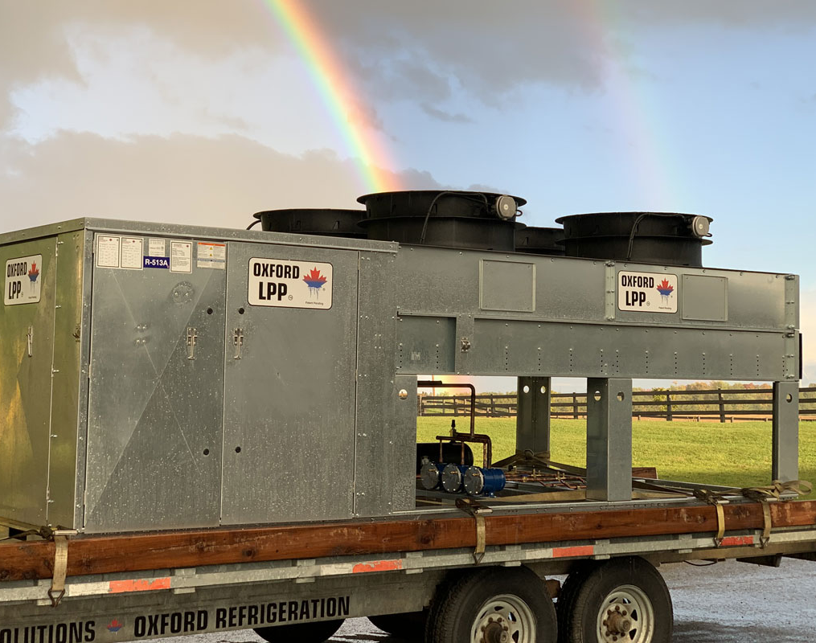



OLPP Life Cycle Design
Considers entire life cycle of equipment
Supply chain efficiency
Zero Leak-rate strategy
Lowest GWP design with HFO refrigerants
Design with recycling in mind
Less congestion = less waste
Less energy = less impact
Reduction of refrigerants & oils
Remote connectivity and resolution
Unlimited future adaptability
Best total equivalent warming impact (TEWI) performance

Slide 29

Everything We Create And Leave Behind Has A Carbon Footprint
Consider the Total Life Cycle of Equipment- from the first bolt to the decommissioning of a system
It is our responsibility to tread lightly

Slide 30
Disclaimer:
This presentation was prepared or accomplished by Oxford Energy Solutions Inc. The information and material provided are the opinion and sole property of Oxford Energy Group of Companies where permission is not granted to reproduce it in any way. The purpose of this content is for informational purposes only, making no representation, express or implied of completeness. All information is provided in good faith and not intended to malign any company, manufacturer, or organization in any way.

